Slide 1

GitHub Repo
Team 1

Slide 2







Meet the Team
Project Manager: Zo DiSanto
Project Owner: Melika Zandikarimi
Business Analyst: Jianan Jiang
Lead Developer: Shanshan Li
Developer: Kishore Kanchan
Lead DBA: Rufan Mirganiyev
QA Analyst & Tester: Louise Ngo

Slide 3
GitHub URL
https://github.com/zdisanto/RevolutionArt

Slide 4
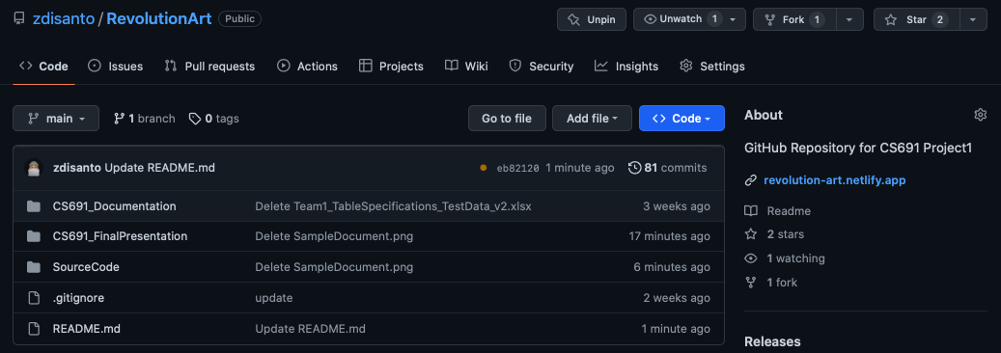
Repository Structure

Slide 5
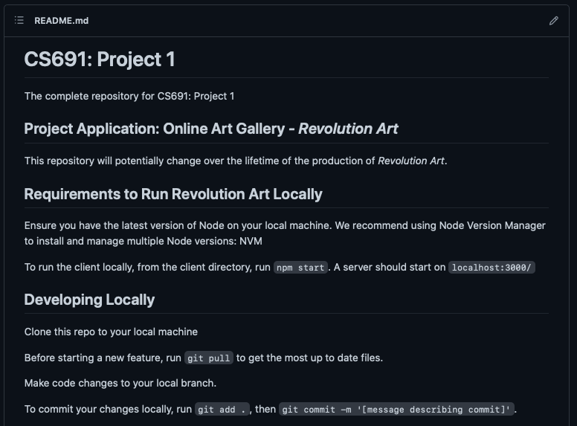
README

Slide 6
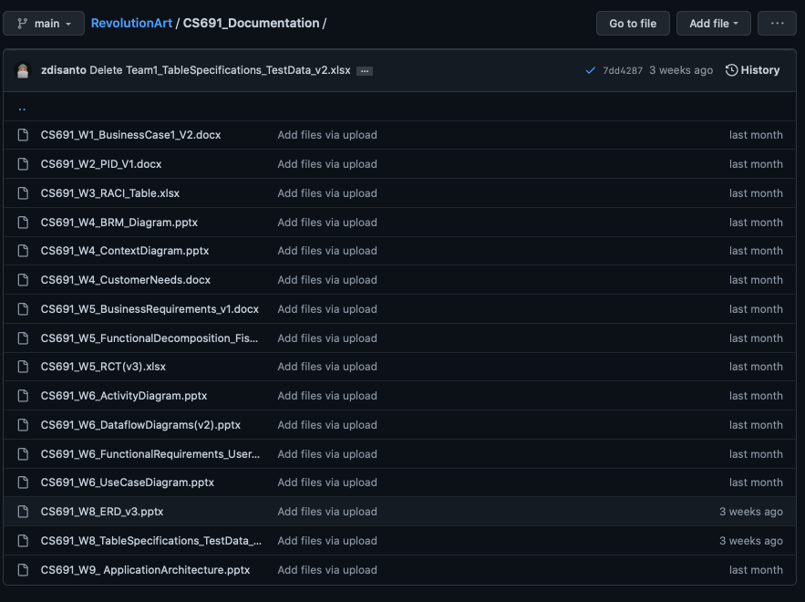
Documentation

Slide 7
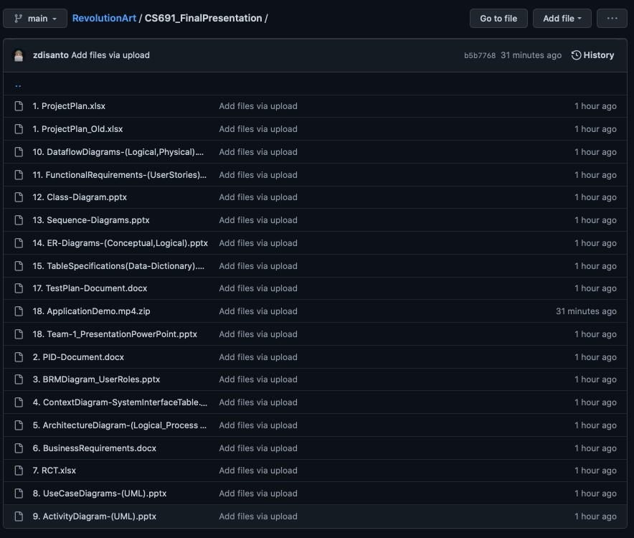
Final Presentation

Slide 8
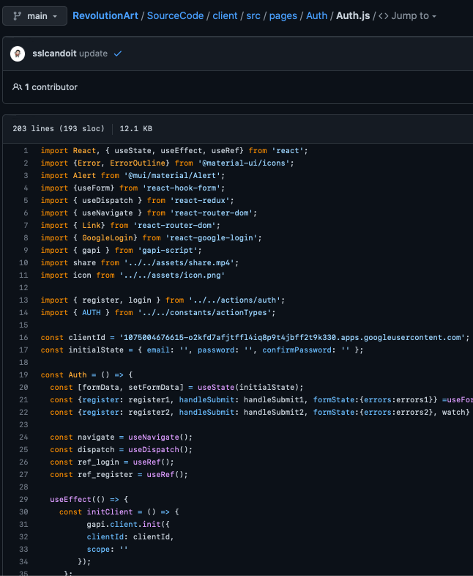
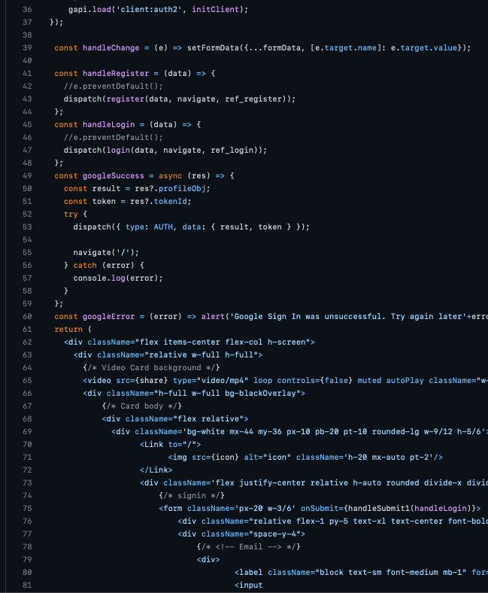
Authorization Code

